Slide 1
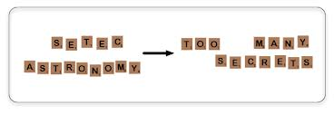
Password War Games
John Alexander
CISSP, CISM, CISA, CEH, CHFI, CDFE

Slide 2
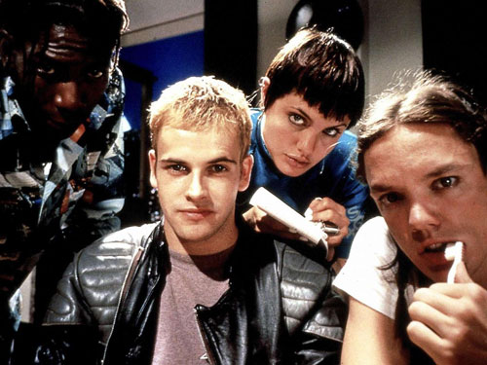
Password War Games
Part I : The Four Password Cracking Techniques

Slide 3
Password Basics – How Passwords are Stored
PASSWORD:
One way Encryption Algorithm
ENCRYPTED PASSWORD:
bone33
6d19f07b3849a96156fe5b18733c07bb
md5
NT Hash
SHA-1
SHA-256
Blowfish
SHA-512
SHA-crypt
bcrypt
scrypt
Example:
Account
Algorithm used (1=md5 in this case)
Salt (“R4mDH”)
jalex:$1$R4mDH$aOcFaA9.Dq6Ww2u3XmCfK/:14641:0:99999:7:::
encrypted password

Slide 4
Basic Password Math Character Complexity and Length
Numbers only = 10^{n}
Lower case only = 26^{n}
Mixed case = (26+26)^{n}
Mixed case + numbers = (26+26+10)^{n}
Mixed case + num + special = (26+26+10+30)^{n}
All ASCII = (256)^{n}
c = number of characters in the character set, e.g. numbers = 10
n = the length of the password
Note: Special characters include the “space” character
Number of password combinations = c^{n}

Slide 5
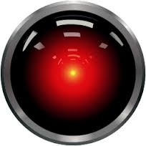
Basic Password Math Examples:
141 = 10³ = 1000
cat = 26³ = 17,576
Cat = (26+26)³ = 140,608
C2t = (26+26+10)³ = 238,828
#2t = (26+26+10+20)³ = 551,368
…..
thecatjumpedoutofthecup = 26²³ =
3,500,000,000,000,000,000,000,000,000,000,000
Character complexity is important but Length is King!!

Slide 6
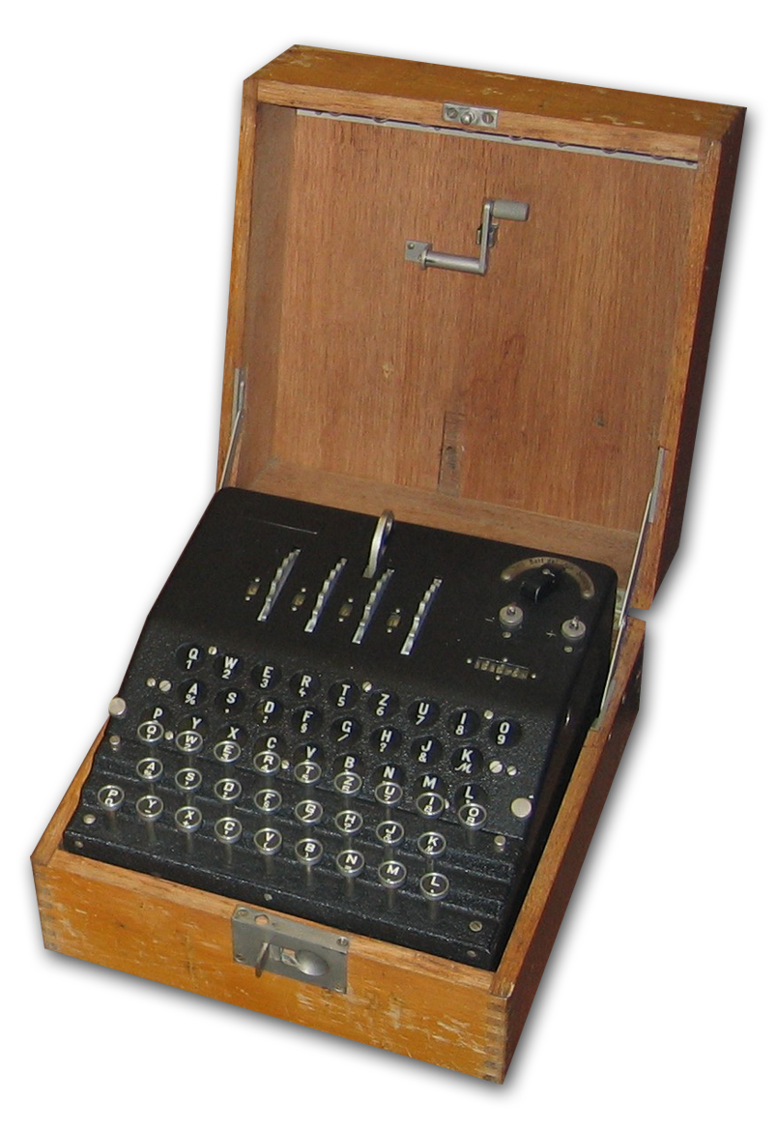
Password Games Hackers Play
Password cracking techniques:
Guessing
Lists of common passwords,
personal information, default passwords
Dictionary
One or more dictionaries to include foreign dictionaries
Hybrid
One or more dictionaries (plus word lists, personal information, and rules)
Brute Force
Random passwords

Slide 7
Quiz Question #1
What is the correct ordering of password cracking techniques from most powerful to least?
Hybrid, Brute-Force, Guessing, Dictionary
Divination, Brute-Strength, Telepathy, Hypnotism
Brute-Force, Dictionary, Hybrid, Guessing
Brute-Force, Hybrid, Dictionary, Guessing

Slide 8
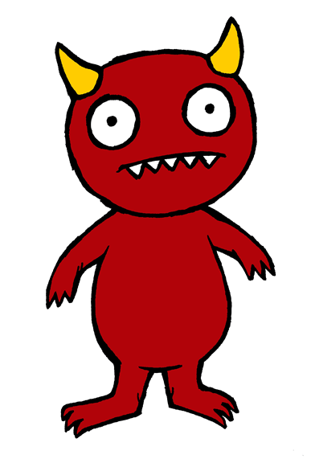
Guessing Attacks

Slide 9
Most Common Passwords
These are some standard common passwords. Common passwords are the weakest of all password types. Avoid them like the plague:
Common Passwords
password | letmein | sunshine
123456 | trustno1 | opensesame
12345678 | dragon | ashley
qwerty | baseball | passw0rd
abc123 | 111111 | shadow
monkey | iloveyou | 123123
1234567 | master | 654321
Source: Splashdata annual list of worst Internet passwords

Slide 10
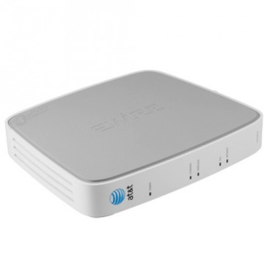
Default and Blank Passwords
Many networking devices come preconfigured with “default” passwords
Many users don’t change this default password
Example: 2Wire Router
Default login user name: admin
Default password: 2Wire

Slide 11
Background Checks
Do Not Use Personal Information — Steer clear of personal information. If the attacker knows who you are, they will have an easier time figuring out your password if it includes information such as:
Names: Your name, Pet Names, Names of family members and friends (e.g. Joshua)
Numbers: Phone numbers, addresses, social security numbers, license plate numbers, zip codes
Dates: Birth dates / anniversary dates
Favorites: Hobbies, sports teams, movie
stars, colors, wine, books, cars, …

Slide 12
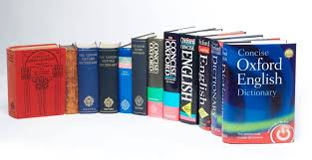
The Dictionary Attack

Slide 13
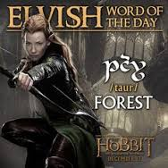
Word Games
Do Not Use Dictionary or Recognizable Words — Words such as proper names, dictionary words, or even terms from television shows or novels
xena
quartet
hogwarts
ds-9
obiwan
Spiderman
taur
khaleesi

Slide 14
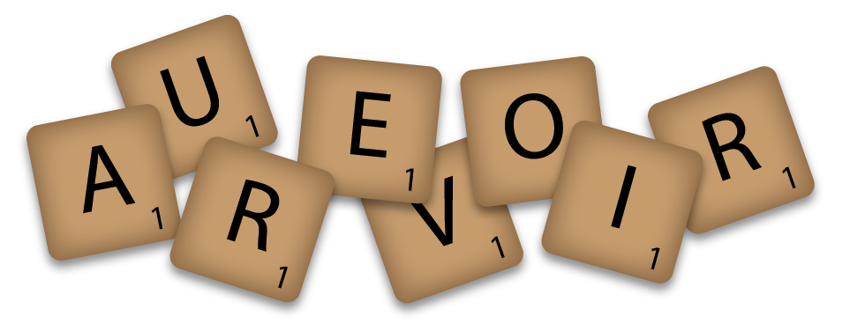
Foreign Language Words
Do Not Use Words in Foreign Languages — Password cracking programs often check against word lists that encompass dictionaries of many languages. Relying on foreign languages for secure passwords is not a good practice. This includes Klingon ;-)
betenoir
bienvenido
gutenmorgen
jlghung

Slide 15
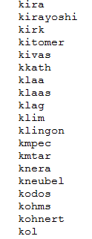
Word Lists
Dictionary attacks can be augmented
by pre-built and custom word lists:
Slang
Jargon
Dirty words
Klingon, Romulan, Elvish word lists, …
Custom lists: SF 49-ers, Star Trek, Jane Austen, Marilyn Monroe, Harry Potter word lists, rock climbing, botanical terms…

Slide 16
Hybrid Attacks (Augmenting the dictionary with rules)

Slide 17
Double Jeopardy
Don’t combine two words:
cathycathy
springale
realginger
elegantpresentation
scissorsauto
brokenmouse

Slide 18
Prefixes and Postfixes
Do Not add numbers or special characters to words
superman7
nevada999
34phonebook
desayuno!@
%%stockmarket

Slide 19
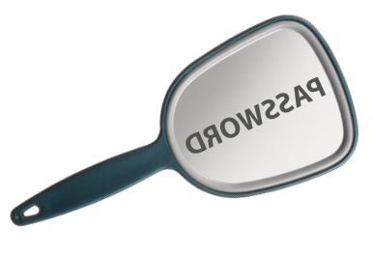
Inversion/Reversal
Do Not Invert or Reverse Words — Good password checkers check for reversed words, so inverting/reversing a bad password does not make it any more secure:
etamitigel
ardnassac
nauj
9-SD

Slide 20
Keyboard Patterns (sequences)
Don’t use simple keyboard patterns:
123
123123
1234567890
qwerty
qwertyuiop
asdfghj
zaqwsx
!@#$%^&*()

Slide 21
Character Substitutions & Leetspeak (elite speak = l33tspeak = leetspeak)
Common Character Substitutions:
$=S, @=A, 4=A, 1=L, 1=I, !=I, 3=E, 0=O, #=H
Examples:
PASWORD = P@$$w0rd
livefish = l!v3f1S#
ELITE = ELEET = 3L33T
n00b = newbie
Iamsurprised:-o

Slide 22
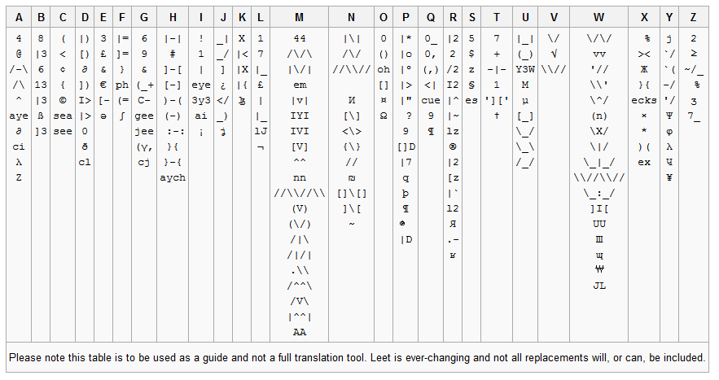
Leetspeak Table (source: Wikipedia)

Slide 23
Don’t Make it Up
Good password cracking programs can check many made up words using something called frequency tables.
Idea is that certain letters follow others more frequently than others in a given language
There are frequency tables for each language
Examples:
markap
yunk
quirp

Slide 24
Quiz Question #2
What is the problem with the following password: minulauck?
Susceptible to a dictionary cracking
Susceptible to hybrid cracking (two words)
Susceptible to hybrid cracking (made up word)
Susceptible to guessing (a common word)

Slide 25
Quiz Question #4
is
abcdefghijklmnopqrstuvwxyz
a strong password?
Yes
No

Slide 26
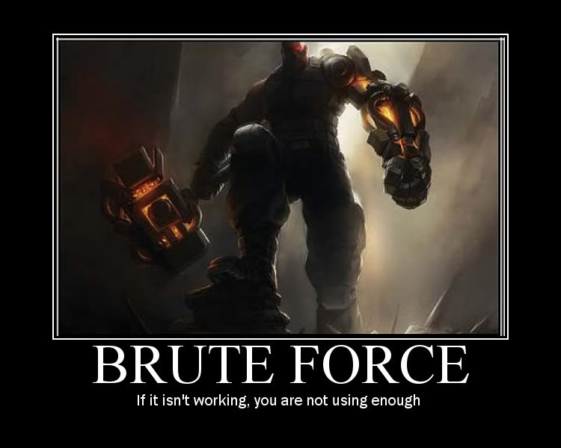
Brute-Force Attack

Slide 27
Brute Force Attacks
When all else fails the cracking software will try every possible combination
Brute-force is somewhat intelligent in its search it will go in a certain order (that can be configured)
Example:
Single character, 2 character passwords, 3 character passwords, 4 digit numbers, 4 character lowercase, 4 character all character, ….

Slide 28
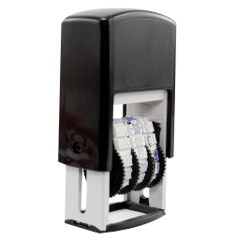
Letters or Numbers Only
Do NOT use only letters or numbers:
8675309
miwhdd
prwlkj
Length is king, but character complexity
is also important in defending against
Brute force attacks

Slide 29
Quiz Question #5
Which of these two passwords is weaker?
stronghold56
Y&f2*e
Or to phrase it another way – which of these passwords will fall first to a password cracking program.

Slide 30
Quiz Question #6
Which of these two passwords is considered stronger (i.e. harder to crack)?
12345678
poilk

Slide 31
Summary
Length is King!!
Avoid dictionary words to include foreign words, made up words, specialty (hobby) words, dirty words…
Be careful with rules – the more entropy the better!! Entropy trumps Cleverness!!
Recommend: Using MFA and a password manager (e.g. 1Password) with randomly generated passwords whenever possible

Slide 32
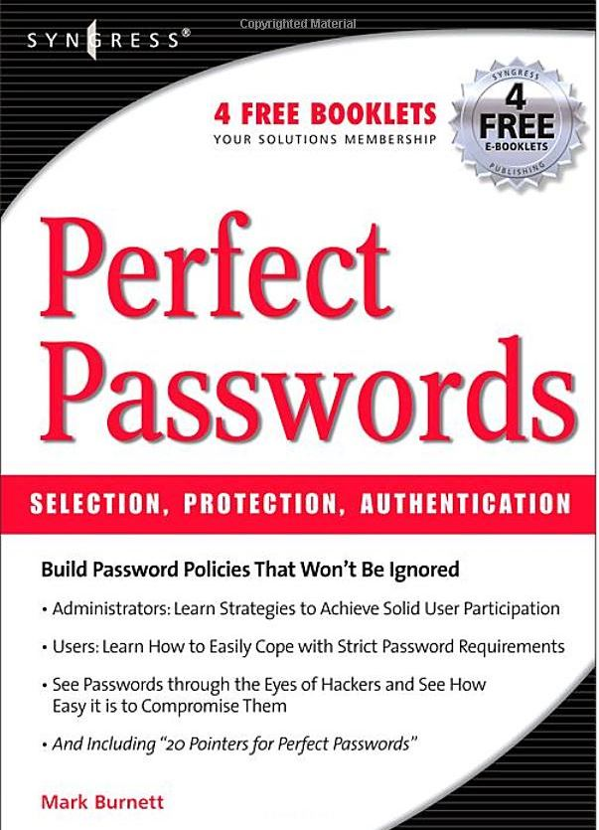
Further Reading

Slide 33
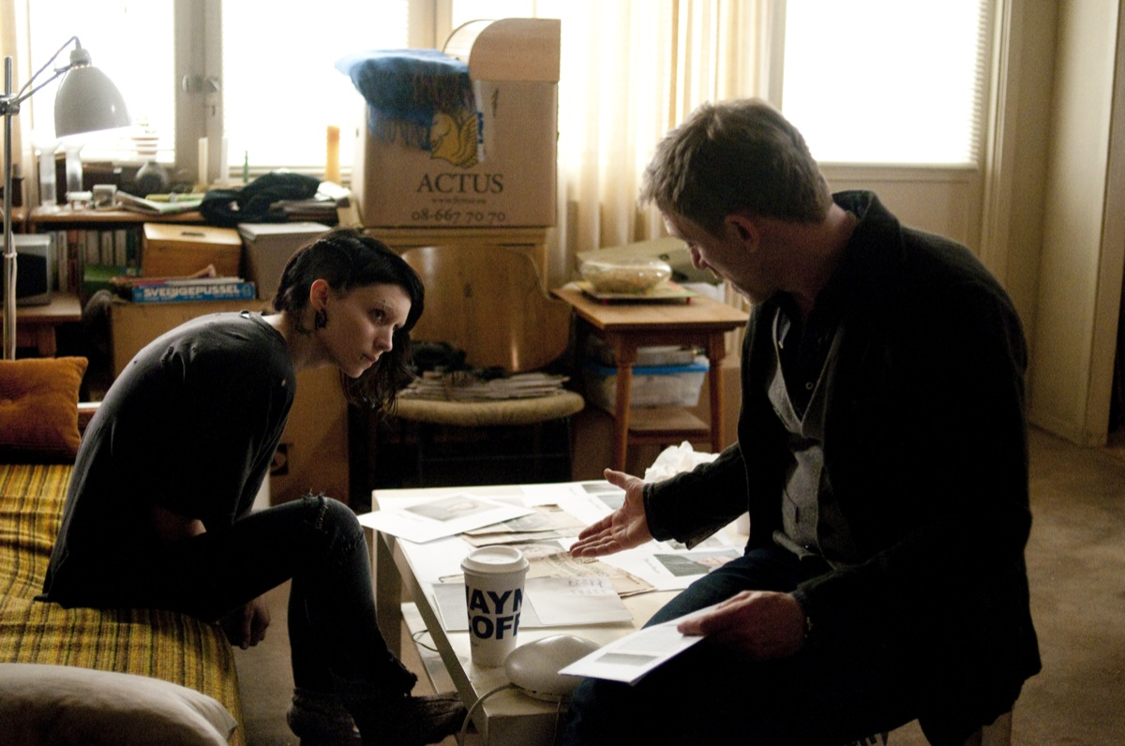
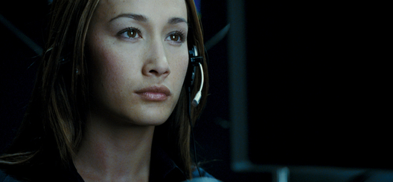
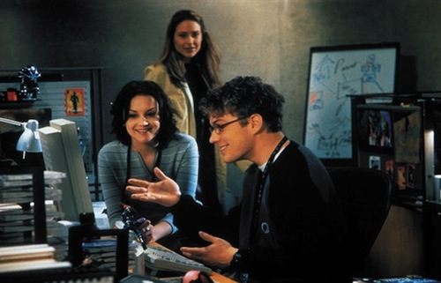
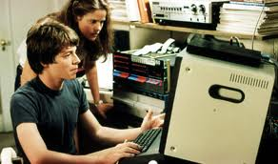
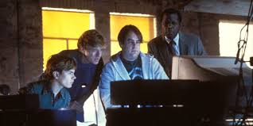
Questions

